Slide 1


Hii, IamSiddhika
Welcome to Power BI Series
Part -34

Slide 2



Today Content
We focus only on the most used and important Dax Functions
I’m soo Excited.
Are you ready guys?
Meet DAX
COMMON FUNCTION CATEGORIES
4. FILTER FUNCTIONS (FEW MORE)
CALCULATETABLE
DIFFERENCE BETWEEN
CALCULATE AND CALCULATETABLE
REMOVEFILTERS
ALL VS REMOVEFILTERS DIFFERENCE

Slide 3


CALCULATETABLE
The CALCULATETABLE function returns a table that is filtered according to the conditions you specify.
Check this
Syntax
CALCULATETABLE(<expression>[, <filter1> [, <filter2> [, …]]])
Suppose we have an "Orders" table with columns "Category", "Product", "Sales" etc. We want to create a new table that only includes rows where the "Category" is "Technology".
Example
This dax returns only rows where the "Category" column equals "Technology" should be included in the new table

Slide 4
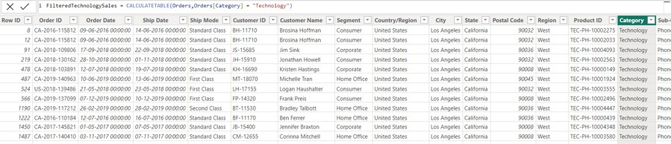

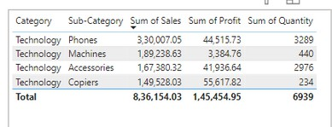

Visual Example for better understanding
After applying the CALCULATETABLE function, the new table FilteredTechnologySales will look like this:
Understood?
Imagine you have a report where you need to analyze sales data specifically for the "Technology" category. Using the CALCULATETABLE function, you can create a new table that includes only the relevant data, making it easier to perform further analysis or visualizations focused on "Technology" products.
By using CALCULATETABLE, you can dynamically create filtered tables based on various conditions, allowing for more flexible and powerful data analysis in your reports.

Slide 5
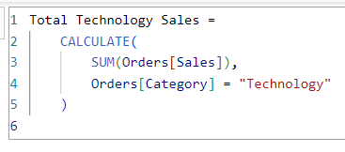

Understanding Difference Between CALCULATE and CALCULATETABLE
CALCULATE: Used in measures and calculated columns for modifying filter contexts and performing calculations.
CALCULATETABLE: Used to create new tables based on filtered data, which can then be used in other DAX expressions or visualizations.
Understood?
CALCULATE: Returns a scalar value
CALCULATETABLE: Returns a table.

Slide 6
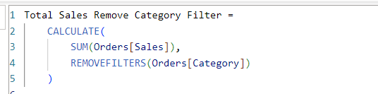
REMOVEFILTERS
The REMOVEFILTERS function in DAX is used to remove filters from the specified columns or tables. This can be useful when you want to calculate a value that ignores certain filters applied in the current context.
Check this
Syntax
REMOVEFILTERS([<table> | <column>[, <column>[, <column>[,…]]]])
Example
Suppose we have an "Orders" table with columns "Category" and "Sales". We want to create a measure that calculates the total sales amount across all categories, ignoring any filters applied to the "Category" column.
This removes any filters applied to the "Category" column, ensuring the total sales amount is calculated for all categories, regardless of any category filters in the current context.

Slide 7
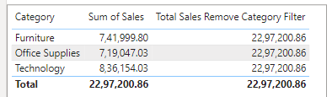
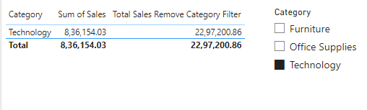
Visual Example for better understanding
Understood?
Imagine you have a report where users can filter sales by category. Even if the user selects only "Technology" category, the Total Sales Remove Category Filter measure will calculate the total sales amount across all categories, ignoring the filter applied to the "Category" column.
In this example, even though the user has filtered the report to show only the "Technology" category, the "Total Sales Remove Category Filter" measure calculates the total sales amount across all categories , ignoring the filter applied to the "Category" column.

Slide 8
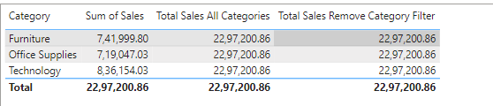
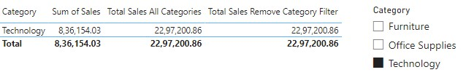
ALL Vs REMOVEFILTERS Difference
Understood?
While both functions remove filters, there is a significant difference in their behavior:
ALL: Removes filters and returns a table or a column, which can be used in other DAX functions like CALCULATE and SUMX. This makes it possible to create complex
measures and calculated columns based on unfiltered data.
REMOVEFILTERS: This function does not return a table or a column; it only removes filters from the specified table(s) or column(s). You can use it within a CALCULATE function to remove filters, but unlike ALL, it cannot be used in conjunction with other
DAX functions like SUMX.

Slide 9


Thank you for joining me today to learn about Part -34 of Power BI!
Remember, Learning DAX is key to unlocking the full potential of Power BI for insightful reporting and visualization.
Stay tuned for more insights and tips on Power BI in our next Series.
Follow
Siddhika Shah

